Slide 1
AIR-FARE PREDICTION

Slide 2

01
Business Problem
02
Data Fetch & Why we take 2019 data
CONTENTS
03
Problems we faced in dataset
04
Questions with Graph
05
Model & Deployment

Slide 3

Business Problem…
For a traveller it is important to know the fare value of a trip, and as prices of flight ticket varies abruptly and it becomes hectic for a user to check different websites, use different deals. A flight fare prediction model will help inform the travellers with the optimal time to buy their flight tickets and understand trends in the airline industry.

Slide 4
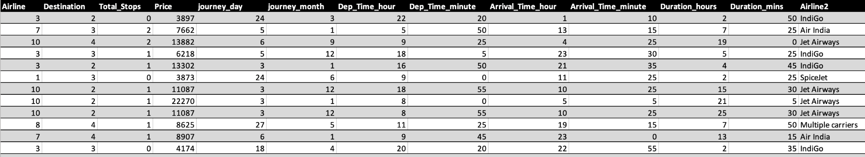
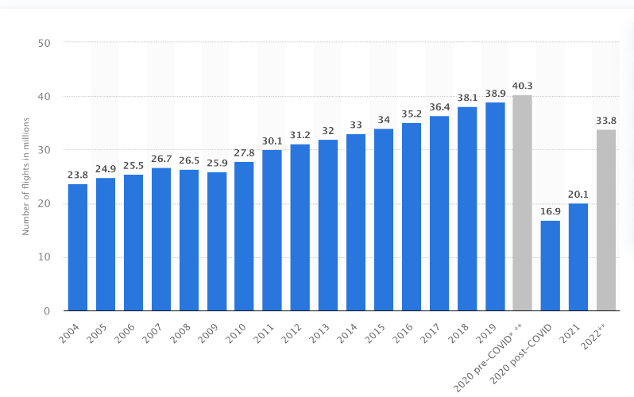
Data Fetch & Why we take 2019 Data…
Statista.
We are using 2019 data as it represents the most recent period with stable data prior to the onset of the COVID-19 pandemic, for which there is no consistent data available afterwards.

Slide 5
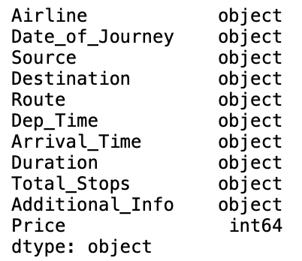
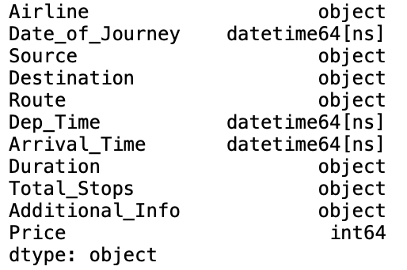
Problems we faced in the Dataset…
Null Values Treatment.
Date & Time columns have an object datatype.
to_datetime
Before
After
Outlier.

Slide 6
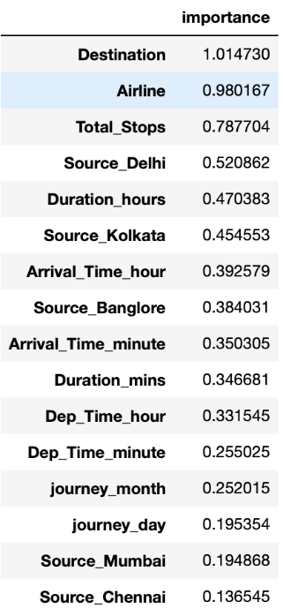
….…
Encoding Techniques.
One-Hot Encoder
Label Encoder
Performing Feature Selection.

Slide 7
QUESTIONS

Slide 8
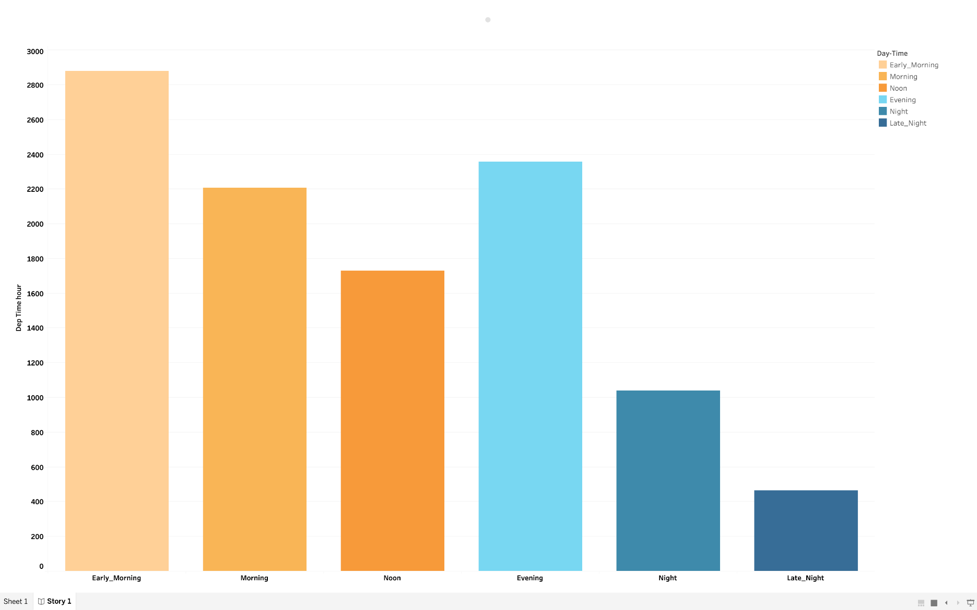
When is the major time slot for most flight departures ?

Slide 9
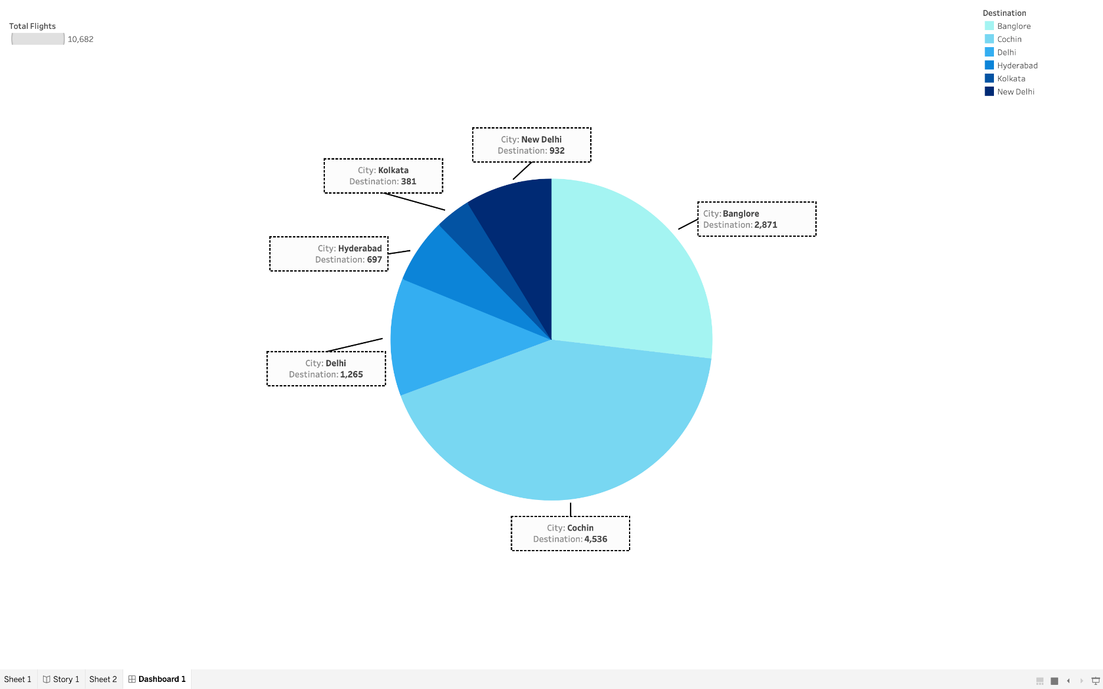
Which city has the highest number of flights ?

Slide 10
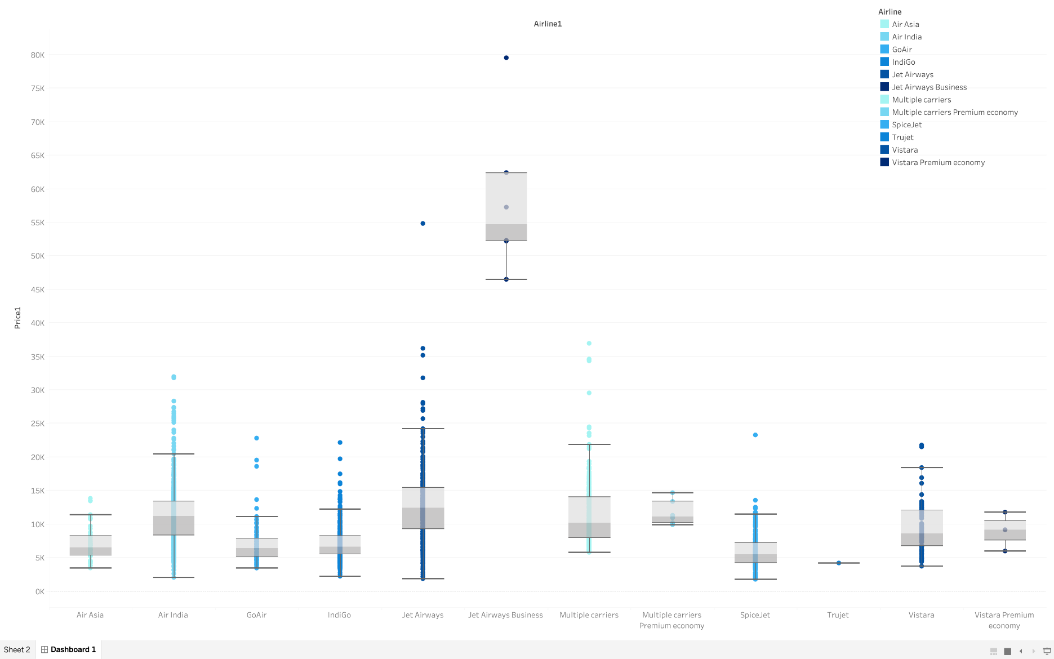
What is the Airline with the highest price ?

Slide 11
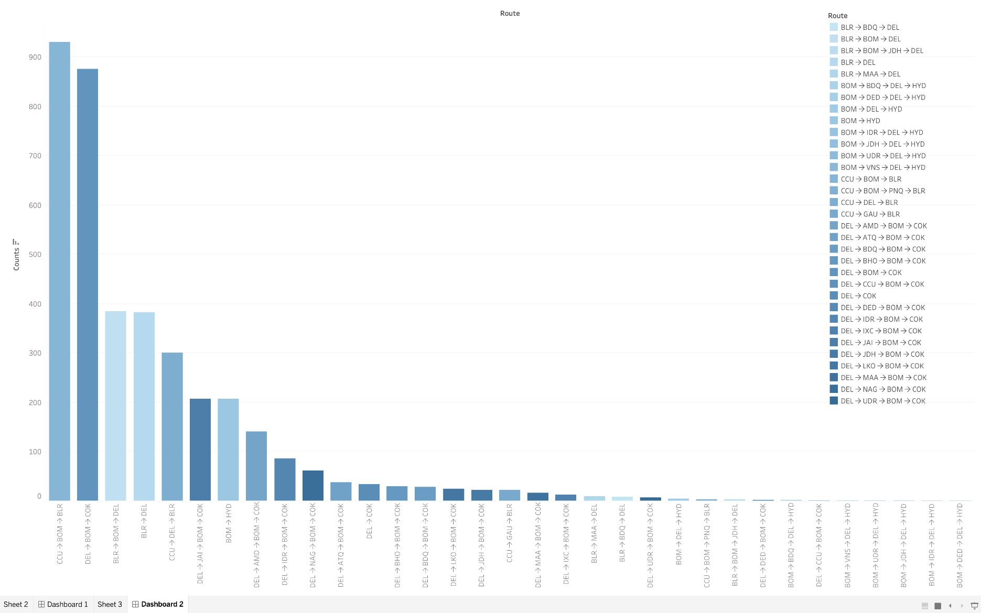
Which routes see the highest usage of jet airways ?

Slide 12
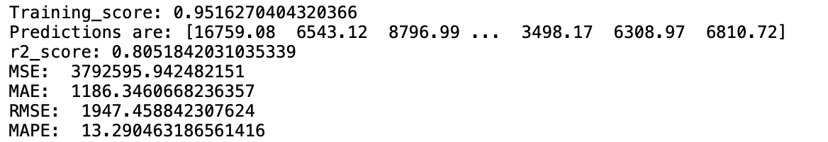
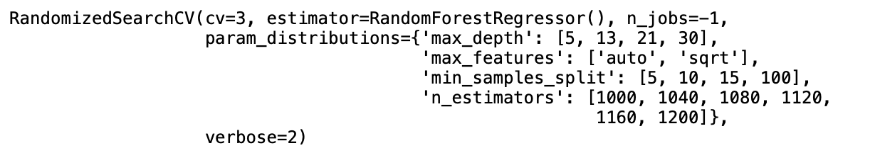
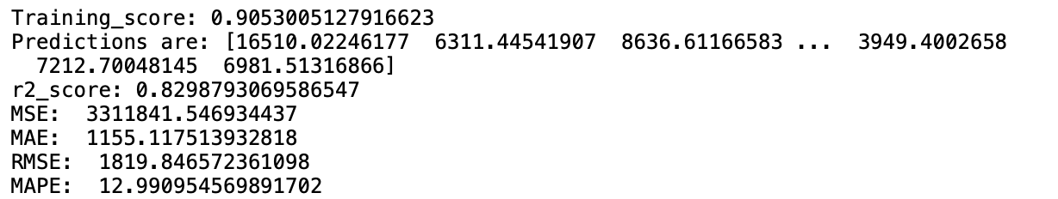
Model…
Random-Forest Regressor.
Hyperparameter Optimization.
RandomizedSearch-CV
Best Parameter in RandomizedSearch-CV
{'n_estimators': 1040, 'min_samples_split': 10, 'max_features': 'auto', 'max_depth': 13}
Prediction

Slide 13
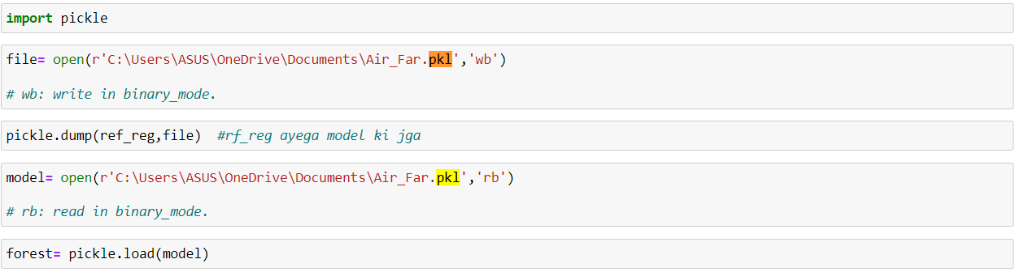
..…
Dump Load ML Model.

Slide 14
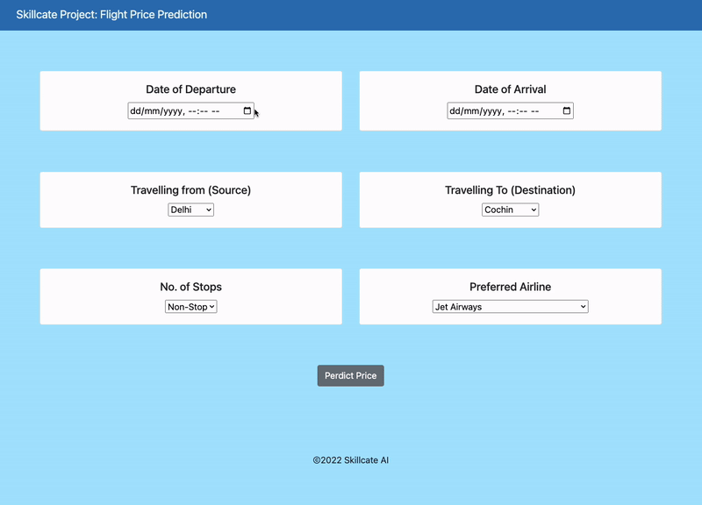
Web-site Overview

Slide 15
THANK YOU

